Slide 1



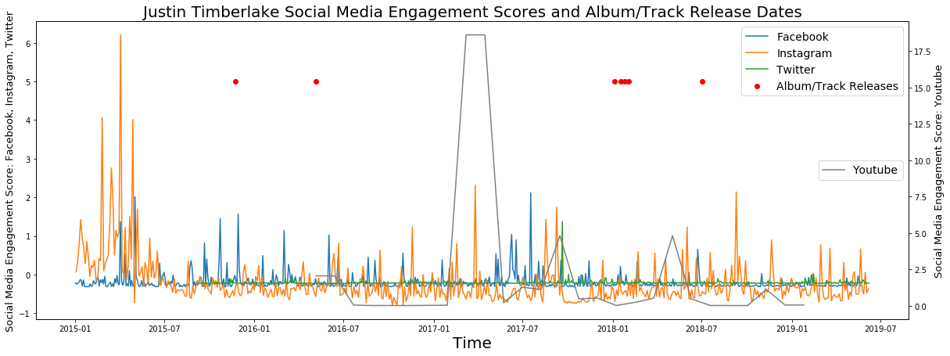
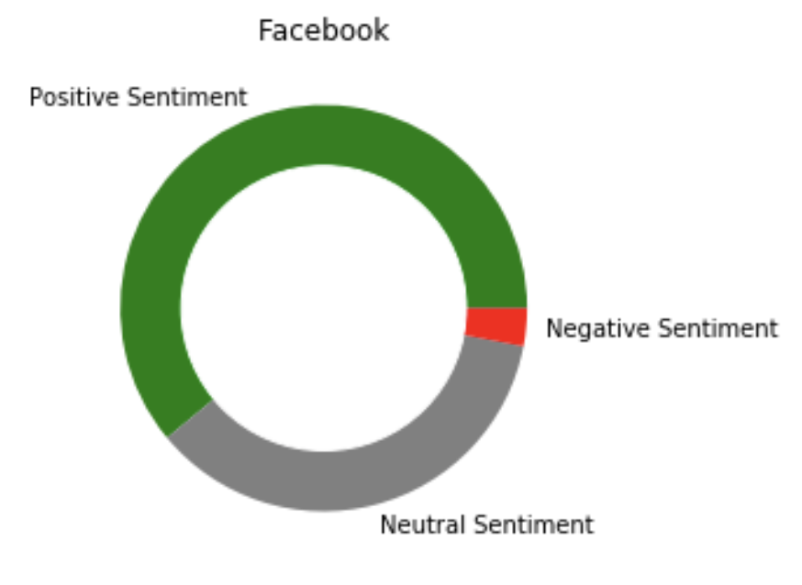
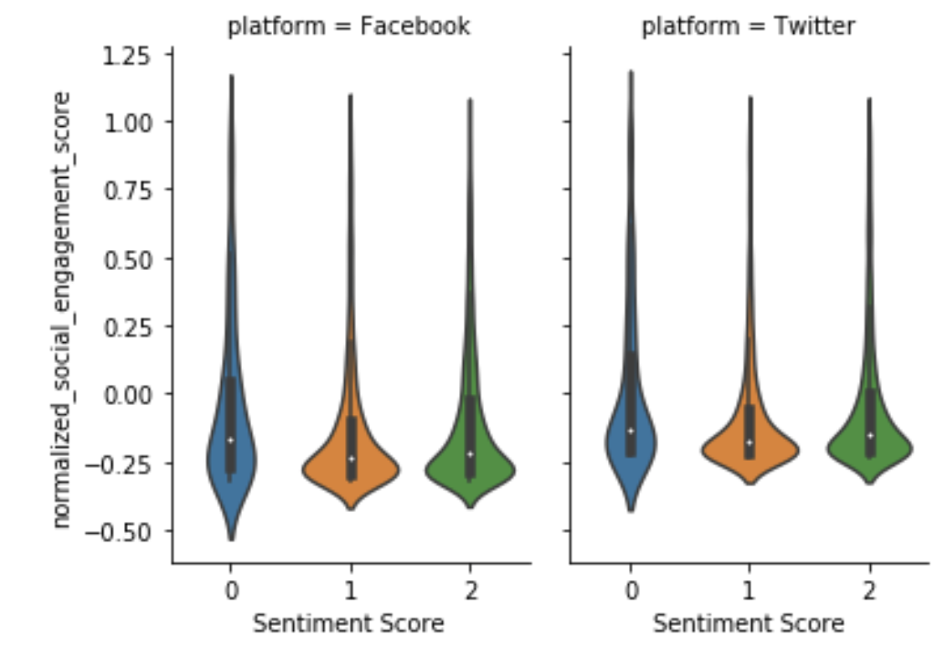

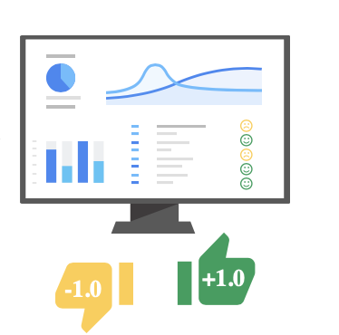
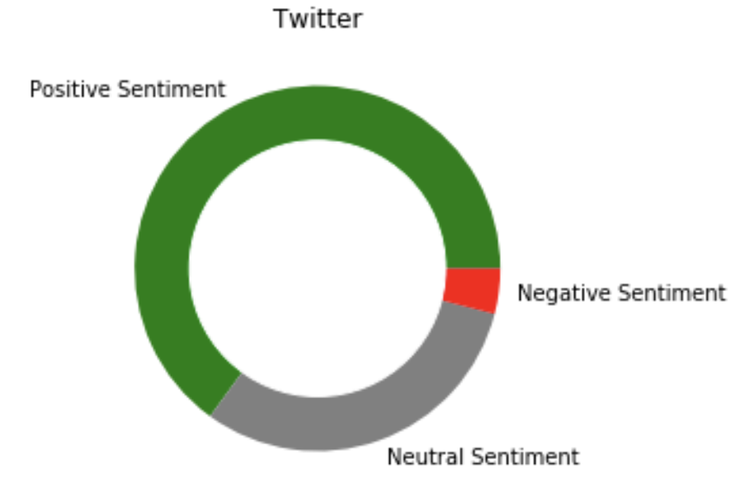
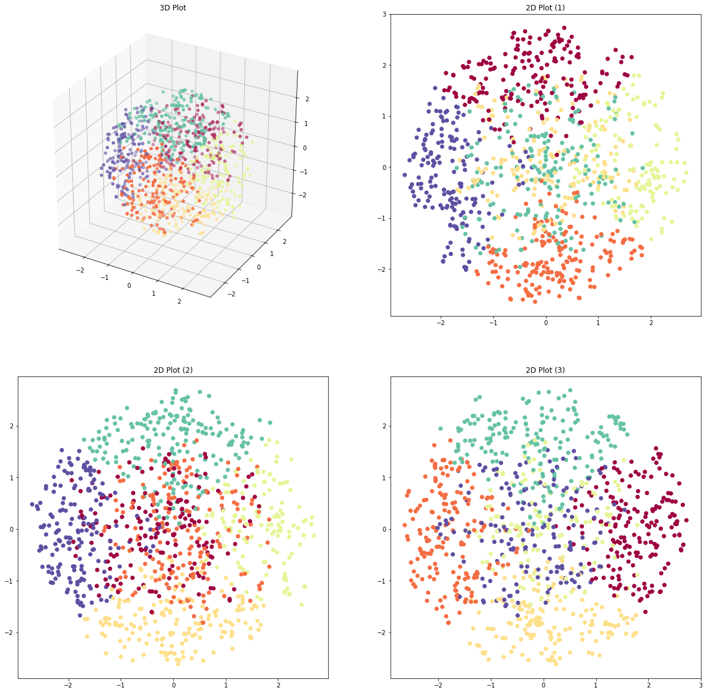





Social Media and Success in the Music Industry
Client: Sony Music – Marc Fridson | Advisor: Michael Smith | Team: Ghazal Erfani, Phani Krishna Pasumarthi, Daniel Lesser, Zhexin Chen, Gaurij Hardikar
Introduction
Exploratory Analysis
Success Prediction
Method
Example: Instagram
Social media music promotion is a necessity in today’s world. Artists are building their own personal brand by engaging with their fans online.
Sony aims to better understand how to promote content on social media and support artist development.
High frequency of posts
Linear regression and feature selection for each social media
A linear regression for 23 features and 214k observations with -0.85 R² score on the test set
Difficult to visually discern relationship between social media activity and engagement
Cross validation with multiple models: Lasso, Ridge, Random Forest, XGBoost, etc
Model selection with cross validation
For a better understanding, we took 3 approaches:
Best model to predict social engagement scores
A XGBoost Regression with 300 estimators and 9 max depth results in 0.58 R² Score on the test set
Purpose
Social Engagement Success Prediction
Social Media Activity Clustering
Social Media Sentiment Analysis
Key Takeaways:
1
Lower post frequency and shorter length posts lead to higher engagement
How does artist activity on Twitter, Facebook, Instagram, and YouTube drive social media engagement?
How does activity differ by platform?
Can we make recommendations around when, where, and how they should engage in social media?
Quantitative
Qualitative
2
Rock artists have higher Instagram engagement
- Positive Coefficient for Rock Artists: (+) 0.122
- High Feature importance of Rock Artists: 0.342
Activity Clustering
Sentiment Analysis
1. Dimensionality Reduction
Method
27 Features
PCA
t-SNE
3 Features
Upload test data to Google BigQuery
2. Gaussian Mixture Modeling
Number of Clusters = 6
Cluster 3
- High Rock &
Electronic Engagement
- Early Morning Posts
- Close to Release-Date Posts
- Would benefit from
more photo posts
Upload training data to Google Cloud
Build custom model using training data
Generate predictions using REST API
Evaluate Results
Data Processing
Key Takeaways:
3D Plot
2D Plot (1)
Cluster 5
- Older Artists
- Afternoon Posts
- High Facebook Engagement
- Would benefit from
early morning posts
1
Most posts have positive sentiment
2
Facebook and Twitter have similar sentiment analysis distribution
6 Genres
3
No significant correlation between sentiment and engagement
141 Artists
Future Work
6 Data Sources
2D Plot (2)
2D Plot (3)
Cluster 4
- Low Post Frequency
- Early Morning Posts
- High Instagram Engagement
- Frequent Twitter Posts
-Would benefit from more Instagram posts
- Would benefit from more photo posts
- Would benefit from
lower-frequency posts
Beyond Social Media Predict artist success on music streaming services based on social media activity across various platforms.
Searching for New Talent Leverage Social Media presence to help music managers identify up-and-coming artists that will contribute to the success of Sony Music
13 Core Features
1M Observations
Notes:
Social media music promotion is necessity in today’s world. Artists are building their own personal brand by engaging with their fans online.
Sony aims to better understand how to promote content on social media and support artist development.

